Slide 1
THE CATHOLIC UNIVERSITY OF EASTERN AFRICA HOTEL MANAGEMENT SYSTEM: A CASE OF SIRITAMU RESORT AND SPA
DIT 020 : RESEARCH PROJECT PROGRESS REPORT
NAME : RODNEY MISOI KIPKEMBOI | REG. Num: 1050932
SUPERVISOR: DOREEN

Slide 2
CONTENT
Background of the Research
Problem Statement
Main & Specific Objectives
Analysis
Design of the database
Implementation

Slide 3
BACKGROUND OF THE RESEARCH
The hospitality sector is a continuously expanding and becoming increasingly reliant on technology. Implementing a hotel management system will automate most of the administrative tasks, enabling staff to focus more on delivering essential services to guests.
Siritamu Resort and Spa, located on the Malaba Eldoret highway in Bungoma, offers excellent hospitality and entertainment for families in a comfortable environment. It is also an ideal venue for business meetings. The resort's product line includes a variety of services such as swimming, multipurpose facilities for meetings, well-appointed rooms, and comprehensive hotel services.

Slide 4
PROBLEM STATEMENT
Despite being an international-class hotel, Siritamu Resort and Spa is not reaching its full potential due to delays caused by the current outdated manual system. Here are the key issues:
Difficulty in locating guest files: with a large number of guest files, locating specific ones during check-in, update daily expenditures, generating receipts, and checking out is extremely challenging for the staff.
Large storage space: The physical files occupy substantial space, filling up about two rooms with storage cabinets that could be better utilized for revenue-generating activities.

Slide 5
PROBLEM STATEMENT
Difficulty in data analysis: Accounting often struggle to analyze guests’ data accurately during the generation of expenditure bills due to missing records.
Unnecessary duplication of data: The current system result in redundant data entry leading to inefficiencies.
Error-prone data entry procedures: Manual data entry is susceptible to errors, compromising the accuracy of the hotel’s records.

Slide 6
MAIN OBJECTIVE
The primary goal is to develop a comprehensive hotel management system that automates most administrative tasks, such as guest check-in, reservation management and billing.
This automation management system will free up staff time, allowing them to focus on delivering exceptional service to guest.
By enhancing operational efficiency and reducing manual workload, the system will significantly improve the overall guest experience.

Slide 7
SPECIFIC OBJECTIVES
Streamline guest check-in and check-out processes: Automate the registration and billing processes to reduce wait times and improve guest satisfaction.
Enhance reservation management: Implement an integrated reservations system that allows for easy booking, modification and cancellation of reservations.
Optimize room allocation and management: Develop a system for efficient room assignment and real-time tracking of room availability and occupancy.
Improve housekeeping and maintenance coordination: enable real-time updates and communication between front desk and housekeeping staff for better room readiness and maintenance management.

Slide 8
SPECIFIC OBJECTIVES
Automate billing and invoicing: Introduce automated billing and invoicing to streamline financial transactions and minimize errors.
Reduce paperwork and physical storage needs: transition to digital recording-keeping to save space and reduce the environmental impact of paper usage.
Integrate Multi-departmental functions: ensure seamless communication and coordination between various departments(e.g., front desk, housekeeping, accounting and maintenance) through a unified system.

Slide 9
ANALYSIS
Functional Requirements
Guest Check-in/Check-out:
Automate guest registration.
Automated room assignment.
Reservation Management:
Modification and cancellation of reservation.
Guest information management:
Real-time tracking of room availability and occupancy.
Easy retrieval and update of guest information.

Slide 10
ANALYSIS
Room management:
Real-time tracking of room availability and occupancy.
Efficient room assignment.
Housekeeping coordination:
Real-time update for housekeeping tasks.
Billing and invoicing:
Automated invoice generation.
Security and access control:
Secure login for staff and administration.

Slide 11
ANALYSIS
Non-Functional Requirement:
Performance
System should be able capable of handling traffic volumes and maintaining performance under heavy user load.
System should handle concurrent access by multiple user without lag
Reliability
System must be reliable with minimal downtime.
Usability:
User-friendly interface for both staff and management.

Slide 12
ANALYSIS
Scalability:
Ability to handle increasing number of guests and data.

Slide 13
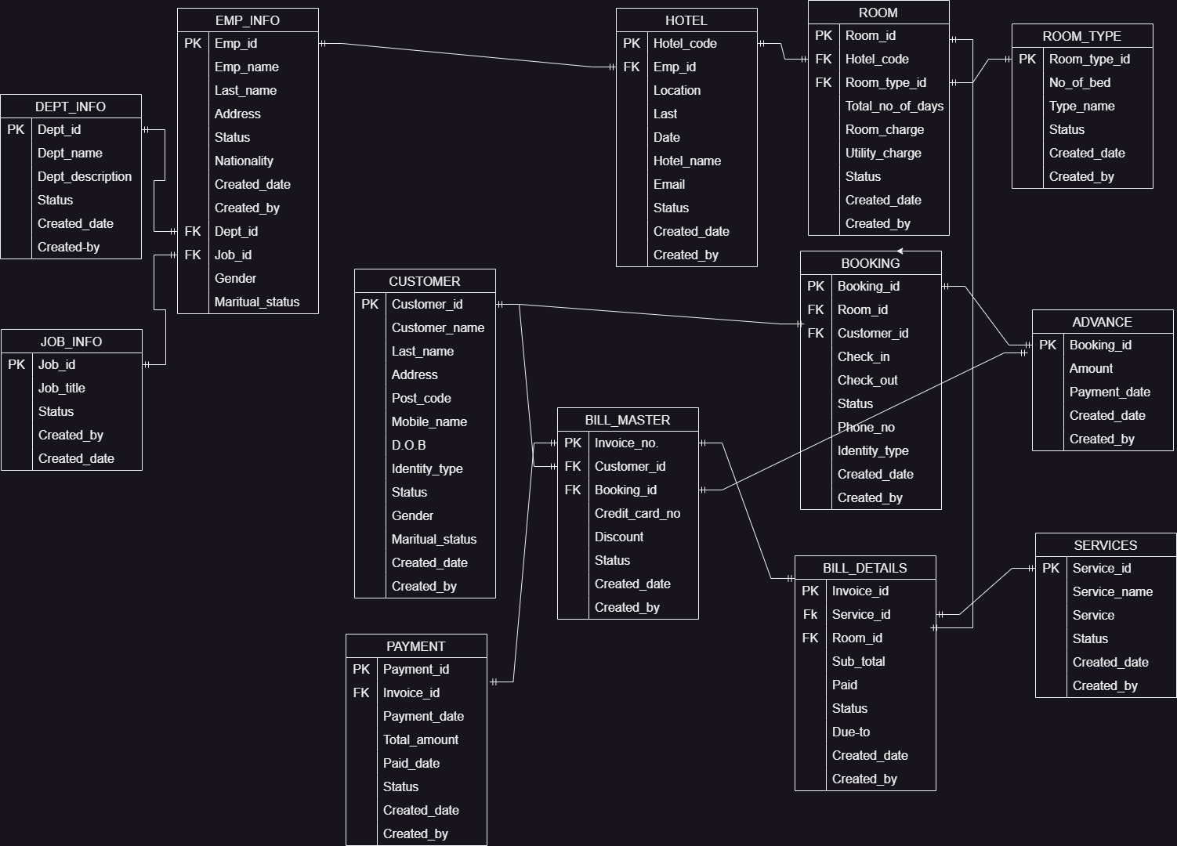
DESIGN OF THE DATABASE

Slide 14
IMPLEMENTATION
The researcher has conducted a research on the material needed for designing the VB-based system. Example searched on resources on Visual Basic programming, user interface design principles.
The researcher has collected the minimum and recommended specifications for hardware example: Laptop, 8GB RAM, flash drive.
Collected software and tools example: Visual studio, SQL server.
Created a database schema and data flow diagram

Slide 15
The End
Thank you
[proceed to invite the panel to your system /prototype presentation]

